Slide 1
End-to end Tracing, tracing Kubernetes
Aditya Chechani
Joshua Manning
Reet Chowdhary
Runzhou Han
2/8/2018
Taiga: https://tree.taiga.io/project/msdisme-2018-bucs528-template-7/
GitHub: https://github.com/BU-NU-CLOUD-SP18/Cross-Layer-Tracing-in-Kubernetes
Notes:
‹#›

Slide 2
Container
*
Containers provide an isolated environment with a unique namespace
The environment satisfies a description of a set of resources required by an app
Each App runs in a different container
An app can only use the resources defined in this namespace
App doesn’t know what is outside its container
Application
Web server, readable file system
Container
‹#›

Slide 3
Kubernetes
*
Kubernetes is an orchestration system coordinating a highly available cluster of computers for deploying, scaling and managing containerized components of a distributed application in a datacenter. It makes these applications agnostic and isolated from other containers deployed on the same node e.g. machine.
It allocates resources to containers to have them meet the required description
It offers a unique namespace to each container
It can scale in & scale out an application and make replication) when required
Provides an abstraction through which each container is able to communicate with the outside world
‹#›

Slide 4
But why Kubernetes?
Better management through modularity.
Faster Development.
Achieved using Pods.
Deploying and updating software at scale.
Scalability
Visibility
Time Saving
Version Control

Slide 5
Components of Kubernetes
Containers
Control Plane
The decision making part of Kubernetes which decides what has to be done with each containers according to its description
Data Plane
This is the part which enforces all of control plane’s decisions
Allows applications to remain agnostic to their surroundings
e.g: Post Service

Slide 6
Tracing
*
To understand the performance/correctness of deploying distributed applications, many parts e.g application, networks, dataplane, control plane etc have to be understood.
Tracing: Trace events labeled by a unique ID of a request to know apps’ behavior
Tracing ID is a local variable generated by an app
Propagation of request IDs tied to a specific request
API
API
API
API
”Thread” of Tracing ID
Request
Node1
Node2
‹#›

Slide 7
Tracing
*
Three major components of Tracing
Trace points
Tracing ID propagation
Huge repository storage to store tracing information
API
API
API
API
”Thread” of Tracing ID
Request
Node1
Node2
‹#›

Slide 8
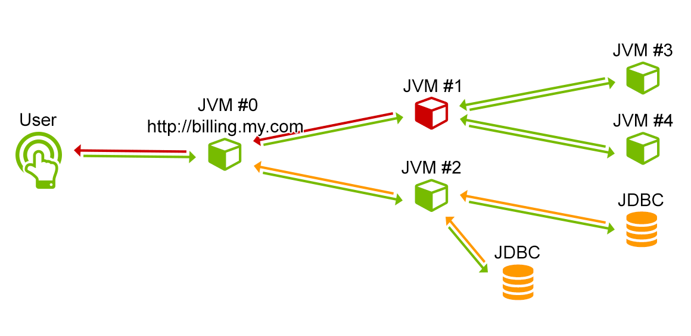
SERVICE #3
SERVICE #1
SERVICE #0
SERVICE #4
SERVICE #2
STORAGE #2
STORAGE #1

Slide 9
End to End Tracing
Tracing is determining the behaviour of each application/container. But what if it is not the application/container which has a latency issue?
End to End (e2e) Tracing is to follow the execution of requests infrastructure along the entirety of its “PATH” of propagation (including its dataplane), to provide detailed tracing for capacity planning and performance analysis

Slide 10
Vision & Goals
*
End-to-end tracing for app behavior on Kubernetes
Trace points (start time, stop time, annotations for remote procedure call)
RPC IDs
Identify issues (bottle necks, latency issues etc.)
Add in trace points to “data plane” features
Ingress - An API object that manages external access to the services in a cluster, typically HTTP.
Services - An abstraction which defines a logical set of Pods and a policy by which to access them - sometimes called a micro-service.
‹#›

Slide 11
Scope & Features
*
Instrument the services section of Kubernetes with trace points
Instrument the ingress features of Kubernetes with trace points
Focus on data-plane portion
‹#›

Slide 12
User Stories
A developer would be able to debug and analyze their deployed distributed applications
Kubernetes developers can look into which requests are present in a particular data plane at some time T.
Performance of a node can be determined
Cloud providers and data centers

Slide 13
Our Users(This part is not sure)
*
Bottlenecks
Facing these problems…
End-to-end tracing
Debug
Kubernetes users,
Including companies and individuals
Latency
Analyze
Performance
‹#›

Slide 14
Challenges
*
Tracing ID is from an app inside a container, how to let it propagate between containers and nodes?
How to make tracing events visible and record them?
‹#›

Slide 15
Example
*
Jaeger: a distributed tracing system used for monitoring microservices-based distributed systems donated by Uber.
OpenTracing: A new, open standard for instrumenting applications and OSS packages for distributed tracing and monitoring.
HotRod: a sample application that can find out drivers nearby.
‹#›

Slide 16
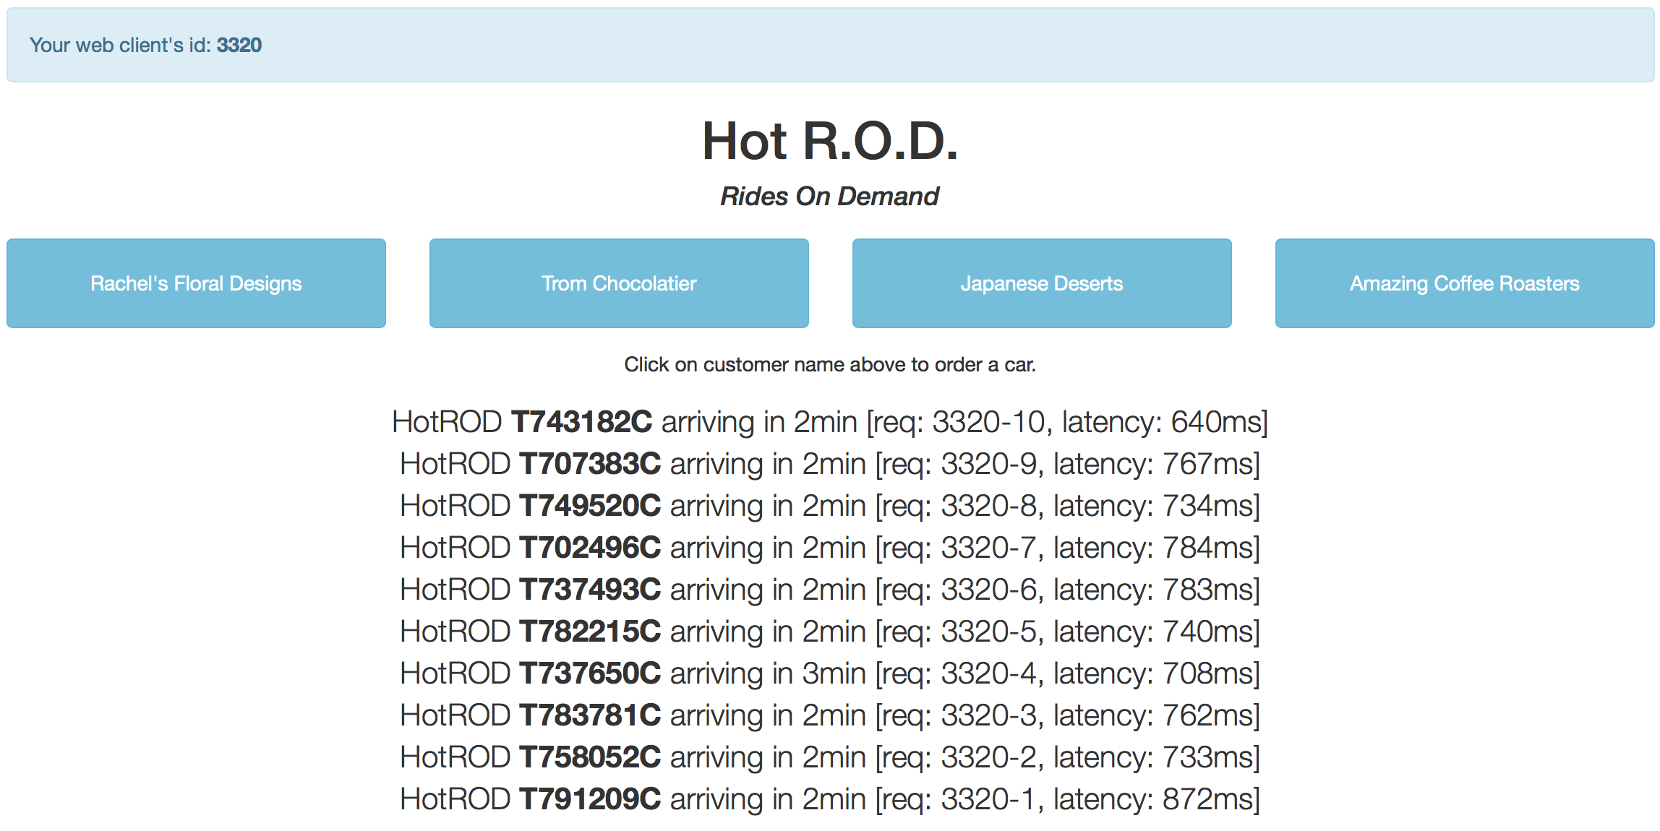
Example
A random ID
Client
Tracing ID

Slide 17
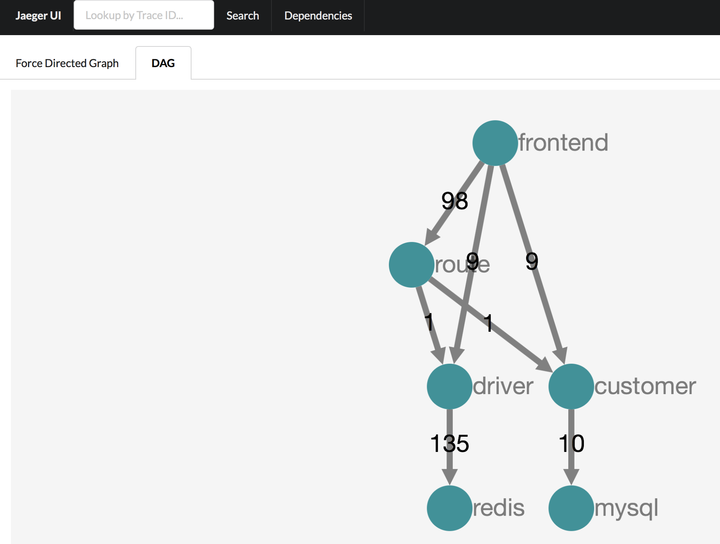
Example
Micro-service
Number of RPCs
Storage backend

Slide 18
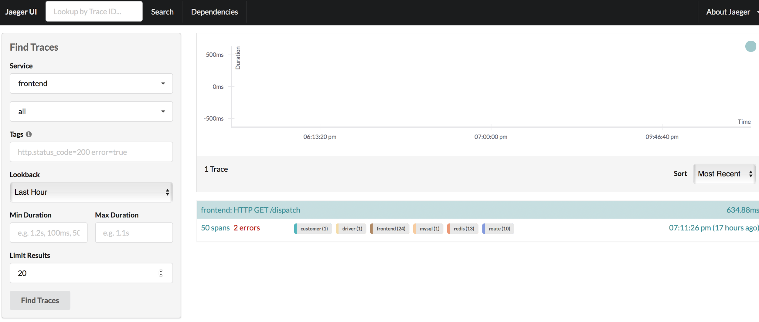
Example
Click here to see entire record and analysis

Slide 19
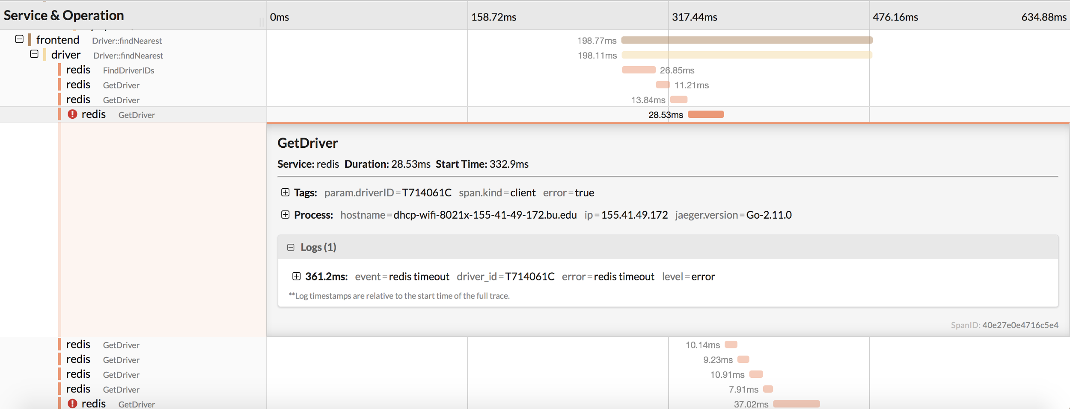
Example
The 2 errors
What causes the error?

Slide 20
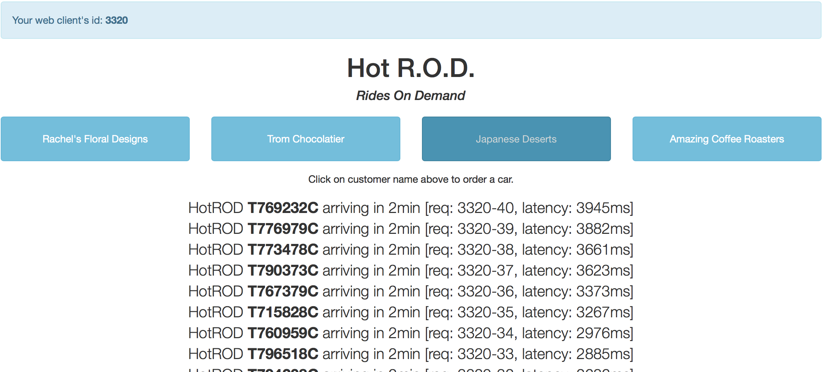
Example
Let’s go to the HotROD UI and click on one of the buttons repeatedly (and quickly).we can see, the more requests are being processed concurrently, the longer it takes for the backend to respond.
Jaeger can detect latency and bottlenecks and find out how to deal with them.
More information click here

Slide 21
Trello
Acceptance Criteria
Propagating a request through the data plane of Kubernetes while making Kubernetes knowledgeable about the metadata being propagated along with the request.
Stretching the capabilities of the already existing tracing systems to the network namespace layer of Kubernetes which could prove to cause a substantial increase in latency and reduction in performance.

Slide 22
MVP(minimum value product)
*
Adding trace points to Kubernetes on TWO data paths of a distributed application in parallel and then have them show up in Jaeger.
‹#›

Slide 23
Release Planning
Short Term Goals:
Get Kubernetes on our machines
Tutorials on Kubernetes & tracing
Containerize Hotrod using a container providing platform. e.g docker.
Implement Jaeger in this containerized Hotrod application as backend to look up the traces and trace points.
Study up on Kubernetes dataplane subsystems e.g HAProxy.
‹#›

Slide 24
THANK YOU
*
‹#›

